Slide 2
A Loving People
A Righteous People
A Unified People
An Obedient People
A Growing People
A Prayerful People
A Sharing People

Slide 3
A Sharing People
Philippians 4:14-16
Nevertheless, you have done well to share with me in my affliction. 15 You yourselves also know, Philippians, that at the first preaching of the gospel, after I left Macedonia, no church shared with me in the matter of giving and receiving but you alone; 16 for even in Thessalonica you sent a gift more than once for my needs.

Slide 4
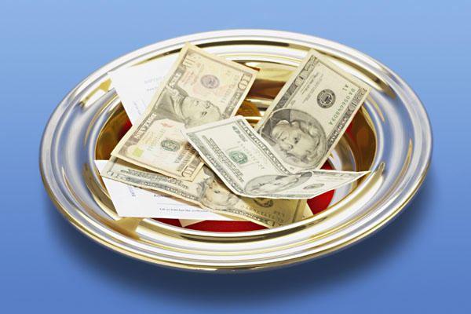
A Sharing People

Slide 5
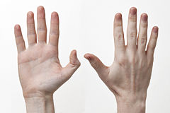
Attention
Action
Attitude

Slide 6
Attention
A Sharing People
1 Timothy 6:17
Instruct those who are rich in this present world not to be conceited or to fix their hope on the uncertainty of riches, but on God, who richly supplies us with all things to enjoy.

Slide 7
Attention
A Sharing People
Acts 5:1-4

Slide 8
Attention
A Sharing People
1 Timothy 5:8
But if anyone does not provide for his own, and especially for those of his household, he has denied the faith and is worse than an unbeliever.

Slide 9
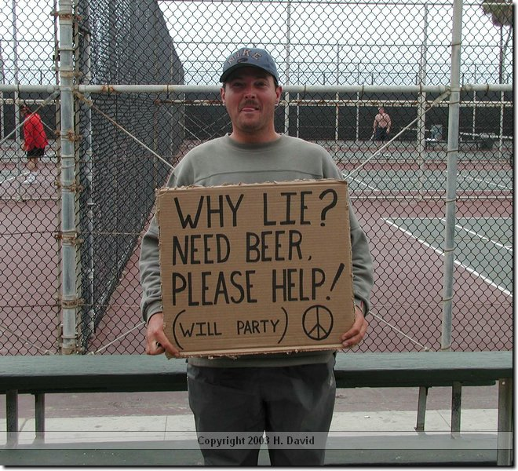
A Sharing People

Slide 10
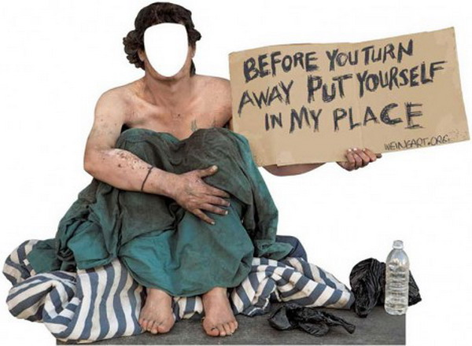
A Sharing People

Slide 11
Action
A Prayerful People
Matthew 26:11
For you always have the poor with you...

Slide 12
Action
A Sharing People
1. Have a benevolence program for nonmembers
a. Have one, or two, people handle requests for assistance.

Slide 13
Action
A Sharing People
1. Have a benevolence program for nonmembers
b. Ask those needing assistance to come to the building to receive support after attending a worship service or bible study.

Slide 14
Action
A Sharing People
1. Have a benevolence program for nonmembers
c. Have gift cards on hand to allow the person to buy groceries at a local supermarket.

Slide 15
Action
A Sharing People
1. Have a benevolence program for nonmembers
d. Have gift cards on hand to allow the person to buy gasoline at a local gas station.

Slide 16
Action
A Sharing People
1. Have a benevolence program for nonmembers
e. Create and maintain a food pantry containing canned item, dry goods and other nonperishable items.

Slide 17
Action
A Sharing People
1. Have a benevolence program for nonmembers
f. Create and maintain a clothes closet. Have members donate clothes, coats and other items useful to those in need.

Slide 18
Action
A Sharing People
1. Have a benevolence program for nonmembers
g. If someone asks for help with utilities pay the bill directly to the organization to whom the money is owed.

Slide 19
Action
A Sharing People
Note, you should also consider a benevolence program for members. This is should coordinated by the elders and privacy should be maintained.

Slide 20
Action
A Sharing People
2. Have a personal benevolence plan as well
a. If you live or work in an area where needs exist keep a care package in the truck of your car to give to those in need.

Slide 21
Action
A Sharing People
2. Have a personal benevolence plan as well
b. Carry gift cards to fast food restaurants and gas stations to give to those in need.

Slide 22
Attitude
A Sharing People
Matthew 6:2-3
So when you give to the poor, do not sound a trumpet before you, as the hypocrites do in the synagogues and in the streets, so that they may be honored by men. Truly I say to you, they have their reward in full. 3 But when you give to the poor, do not let your left hand know what your right hand is doing

Slide 23
Attitude
A Sharing People
1 Peter 1:18
knowing that you were not redeemed with perishable things like silver or gold...

Slide 24
Attitude
A Sharing People
1 Timothy 6:10
For the love of money is a root of all sorts of evil, and some by longing for it have wandered away from the faith and pierced themselves with many griefs.

